Slide 1
MAMC01801 Capabilities for Managers
Week 4

Slide 2
Lessons for managers
The thing that we call “management” is all about establishing and maintaining a productive relationship between the manager and everyone that the manager interacts with – the organisation’s owners, its suppliers, its competitors, its employees, and its customers.The manager who can develop and sustain mutually desirable relationships with this wide range of “stakeholders” is the manager who can rightfully call his or herself a success.
Management is not about “arranging for things to work”, it is about “arranging for people to succeed”,

Slide 3
Agenda
The RBV in the language of surfing
The ASB matrix

Slide 4
group discussion
Read the following articles in the Week 4 folder of the Class Materials folder in Teams:
Can I take your order and your data? The hidden reason retailers are replacing staff with AI bots.
How big tech is crushing telcos – and what One NZ’s Jason Paris plans to do about it

Slide 5
group discussion
Form a group of 4 and in your group, discuss the cases and answer the following:
What are the Black Swans in both cases?
How do you apply the Resource-Based View (RBV) in both articles?
Explain two capabilities of managers needed in those organisations to overcome the threats in the environment
Upload your PowerPoint slides on Teams (Week 4 folder of the Group and Class Activities folder)
Every group member must make a presentation

Slide 6
Systems Theory: The RBV model
As we have seen with our examination of the PESTLE model (and you can take this further by looking at the Black Swan theory), no organisation exists in total isolation from the remainder of the world
Every organisation maintains multiple relationships with multiple stakeholders, and therefore functions as a contributing component of several different, but often interlinked, systems
This is the origin of the concept of an “open” organisation, occupying part of an “open system.”

Slide 7
Systems Theory: The RBV model
The open system includes individuals, organisations, and environments
The relationship between them can be explained by application of a Resource Based View (RBV) of the management function

Slide 8
Applying the RBV model
Very simply, this means that managers should know what their resources are.
They need to know what human resources they have as well as their physical ones.
If something good happens:
Who do they have, to take advantage of it and
What physical resources do they have to help?

Slide 9
Applying the RBV model
If something bad happens, who do they have who can manage a crisis and deploy physical and human resources to make sure the company survives?
How can an organisation develop its staff and physical resources to cope more effectively?

Slide 10
The logic of a Resource Based View
Inevitable and uncontrollable change in the external environment will create a network of opportunities and threats for every organisation.
The organisation’s ability to exploit opportunities and overcome threats will depend upon the specific resources it possesses today and may be able to develop for tomorrow.
The primary focus of a manager is to match the organisation’s capabilities with the opportunities that exist in the external environment.

Slide 11
The logic of a Resource Based View
The RBV process assumes a PESTLE-based understanding of the open systems we live in, in search of possible opportunities and anticipated problems
Accurate identification of opportunities plus perceptive anticipation of problems enhances a company’s prospects.
Success accrues to organisations that make best use of their capabilities to address the demands of the open systems they occupy.

Slide 12
Five golden rules for the RBV Manager
Pursue a genuine interest in the changing world.
01
Develop a detailed understanding of the organisational activity you work in.
02
Research and summarise the current pattern of demand for goods and services.
03
Anticipate the likely future direction of developments in the pattern of demand.
04
Accurately categorise the strengths & weaknesses in your current & potential mix of skills, talents, abilities & resources.
05

Slide 13
Another five rules
Establish a specific long-term ambition in the light of your current and future ability to supply the requirements of a current and future demand environment.
Identify the specific things you need to do well in order to achieve your ambition.
Ensure that everything the organisation does will make some contribution to those “specific things you need to do well”.
Understand and prepare for what could possibly go wrong.
Measure your progress regularly.

Slide 14
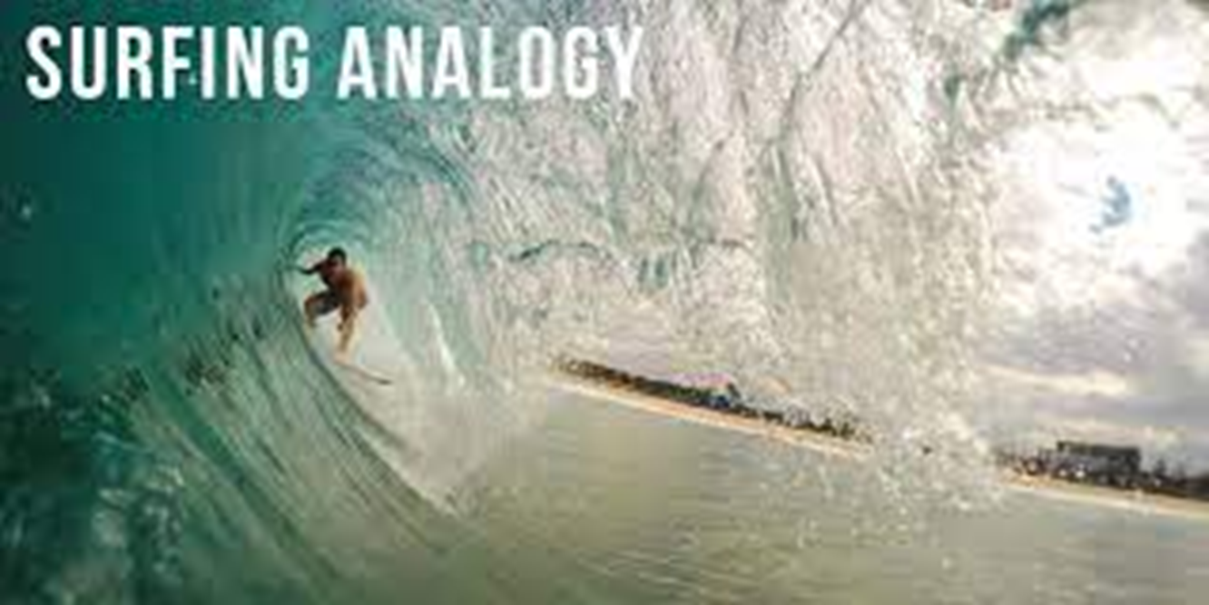

Slide 15
A surf carnival analogy
50 surfers taking part in a competitive event
All 50 take up an offshore position, waiting for the “right” wave to come along
They can let almost any number of waves go by, judging them to be in some way unsuitable to ride
And they will eventually choose to ride a wave that seems to them to be best suited to their individual capability – the wave that will give them the best ride
Once on that wave though, they are unavoidably committed to riding it – there is no going back and beginning again

Slide 16
The surfer’s capabilities
The surfer’s ambition, or the degree of adventurousness in their choice of wave
The surfer’s judgment, or the degree to which that wave behaves as the surfer thought it would
The surfer’s behaviour, or the degree to which the surfer’s skill set is able to take maximum advantage of the wave characteristics.
Who wins and who loses?

Slide 17
Winners and losers
Those who win will have:
- an intimate knowledge of current wave conditions
- done all possible to anticipate future wave conditions
- a clear understanding of his/her own capabilities
- correctly picked the waves to ignore and to ride
Those who lose will have:
- not quite got around to checking the weather forecast!

Slide 18
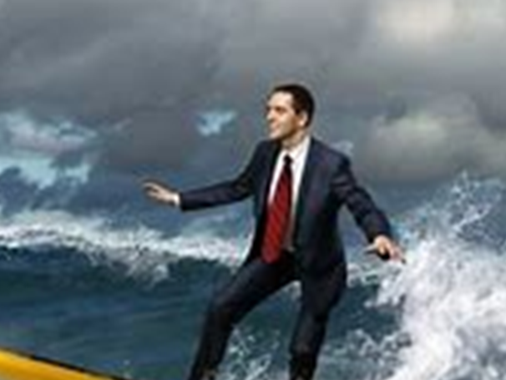
Surfers have to know about . . .
Wind
Waves
Tides
How beaches are shaped
How currents flow, How boards work
Knowing about these, observing them, storing knowledge and using it helps competitive surfers win. The analogy with business is fairly easy to make. We take it for granted they already know how to surf!

Slide 19
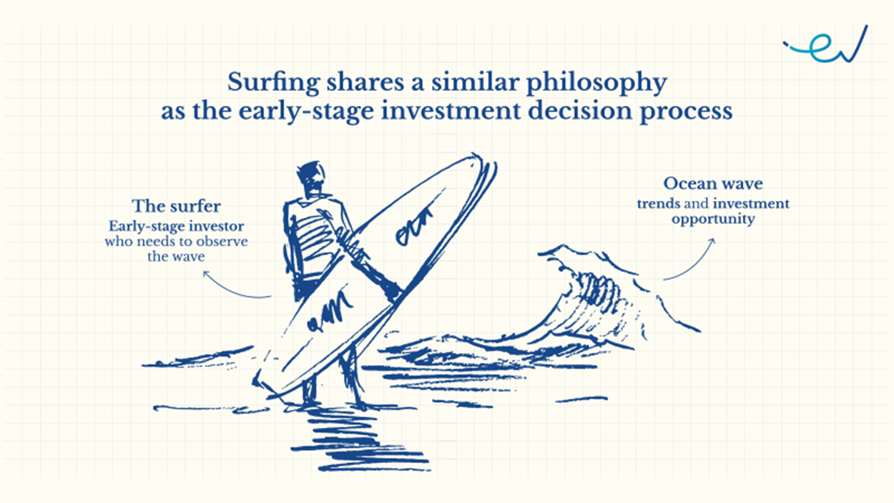

Slide 20
Surfing in organisations
During the course of an organisation’s development, a wide range of opportunities will become available
Each of these opportunities should be analysed in terms of the demands they make on the capabilities of the organisation
Some opportunities will be well matched to the organisation’s capability profile, and should be pursued
Others will be much less so and should be left well alone
Managers therefore need to have a sound understanding of their organisation’s capabilities, and to then develop expert skills in reading the characteristics of environment

Slide 21
Exercise 1: Surfing New Zealand
Think about the New Zealand environment for a moment, and the opportunities that you might be able to see for organisations operating in this country.
What does your intuition tell you about what are the New Zealand opportunity “waves” that should be ignored, and the waves that offer the best chance of a great ride?
With your group to develop what you think are the greatest strengths and weaknesses of New Zealand as an environment for business organisations to work in.
And then develop lists of the most obvious opportunities that might be taken advantage of, and the most serious threats to organisational success
Each group will make an oral presentation to the class and post its findings to the Forum.

Slide 22
Before you start . . . .
Before you start, ask yourself:
What is New Zealand?
Who is a New Zealander?
What markets does it serve?
What can it offer?

Slide 23
New Zealand strengths (www.transitiontowns.org.nz)
Geographically isolated
Good cool temperate to warm temperate climate
Low population
Good agricultural land
Abundant fresh water
Minor but good quality reserves of oil and natural gas
Approximately 60% of electricity from renewable sources
Stable democratic political system
High literacy rate
Socially progressive culture
Good levels of social support
High levels of ingenuity and creativity amongst population

Slide 24
New Zealand weaknesses (www.transitiontowns.org.nz)
Geographically isolated
Geographically dispersed rural and suburban population
Tiny economy, vulnerable to global change
High rate of foreign ownership in wealth creating enterprises
Highly urbanized, but no tradition of local community life
Poor urban, very poor rural and inter-city, rail links and services
Very little manufacturing exists
Agriculture based on animals rather than crops
Significant dependence on food imports
High rate of private car ownership
Transport 99% dependent on fossil fuels
Prevalence of neo-classical economic views in authoritative national institutions (e.g. government, universities, media)

Slide 25
One possible summary
NZ is virtually self-sufficient in food production, but is otherwise highly import-dependent
It sells too much of its primary produce as commodities rather than as high value-added products.
Its people are very creative but have a limited ability to profit from that creativity
High levels of aspiration to self-employment means most activities are “over-shopped”
Competitors in those activities are almost exclusively small or even micro sized
Small organisations’ technical skills are strong, generic management abilities are very weak.
Organisational growth is hindered by generally low levels of ambition amongst owners
Organisational development planning is similarly absent in many small firms
What do you think?

Slide 26
Attitudes, Skills, and Behaviours (ASBs)
An attitude is a deeply held belief, originating from one’s own innate personality characteristics, ethnicity, upbringing, peer group influence etc., that determines what each of us believes to be right or wrong, positive or negative, desirable or undesirable, achievable or unachievable etc.
Skills are defined as what a person is able to do – note that this doesn’t necessarily mean that this same person will use those skills, it just means the person is able to use them .... if he or she wants to.
Behaviours occur as a the result of combining attitudes and skills, and in this respect can reflect the outcome of four different combinations.

Slide 27
The ASB matrix
The ASB matrix is designed to correlate performance and attitude to identify how staff are performing. It consists of four possibilities that show how these elements combine and the likely outcome. The results can be summarized this way:
Positive attitude + high skill = excellent behaviour
Positive attitude + low skill = enthusiastic but ineffective behaviour
Negative attitude + high skill = disinterested and inefficient behaviour
Negative attitude + low skill = damaging and destructive.
You can read this for more information:
Performance/Attitude Matrix
https://workplaceculturesolutions.com/leadership-blog/2017/4/2/the-performanceattitude-matrix

Slide 28
Managerial influence over ASBs
The most important ASBs are those of the manager: his or herself. We cannot influence the ASBs of others until we have first understood, developed and maintained a positive ASB profile for ourselves
What then should the manager’s ambition be, both for his or herself and for the other people s/he is required to interact with?
The secret of success here lies with the manager’s ability to interact and positively influence the ASBs of a wide range of organisational stakeholders

Slide 29
Managerial influence over ASBs
“Stakeholders” are those persons with a legitimate interest in what the organisation chooses to do or not do.
The behaviour element of ASBs has traditionally been the one which managers will most likely be required to work with
It is certainly the most overtly obvious and therefore the easiest to measure

Slide 30
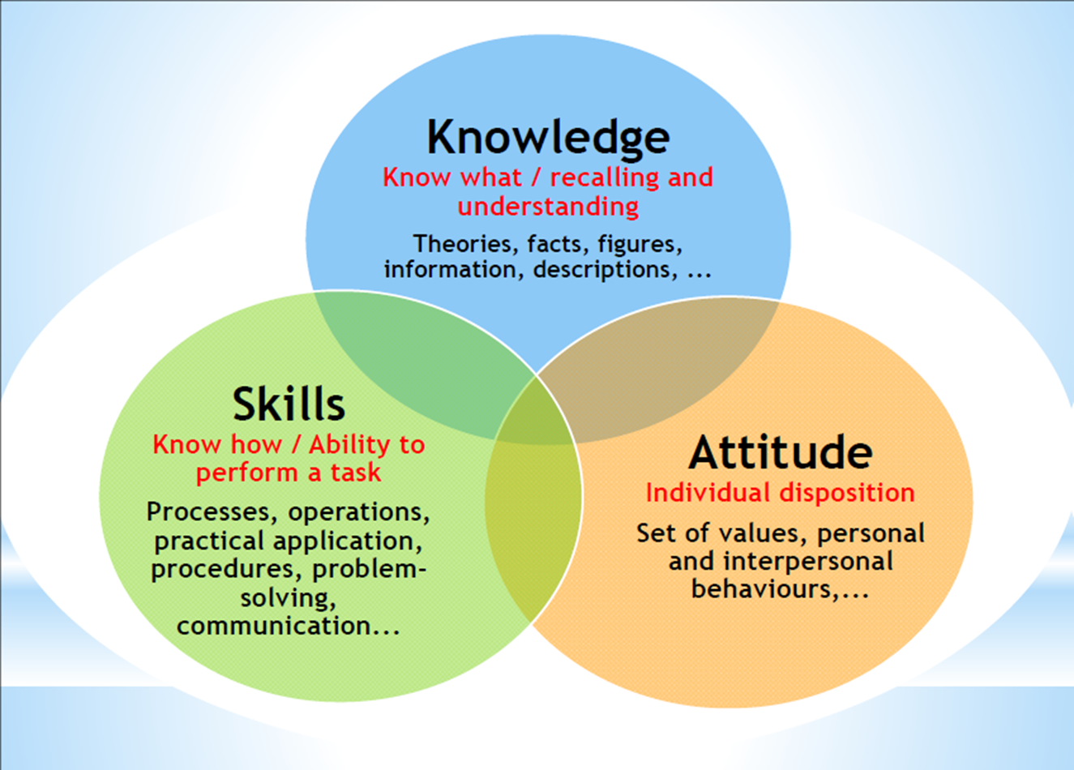

Slide 31
group discussion
Form a group of 4/5 people and carry out the following class activity with all your heart:
What are organisational values and why are they important in a business context?
Identify 3 Maori values in an organisational context. How do these values manifest in an organisation's operations?
Find another group and present your discussions to that group. The group will evaluate your answers based on:
Clarity (on a scale of 1 to 10, where 1 is poor and 10 is excellent)
Substance (on a scale of 1 to 10, where 1 is poor and 10 is excellent)
Then the other group will present, and your group will evaluate on the same criteria as above.

